Slide 1

Ski Trip
2024
Somewhere in Italy
What will it be like?

Slide 2
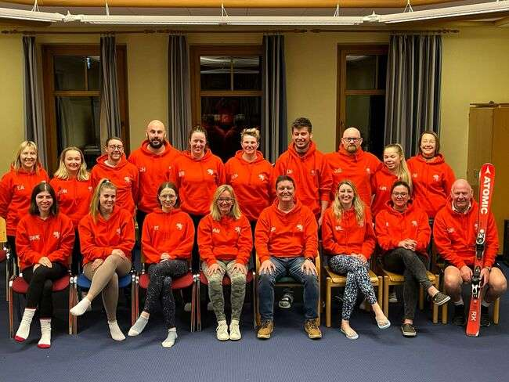

Slide 3
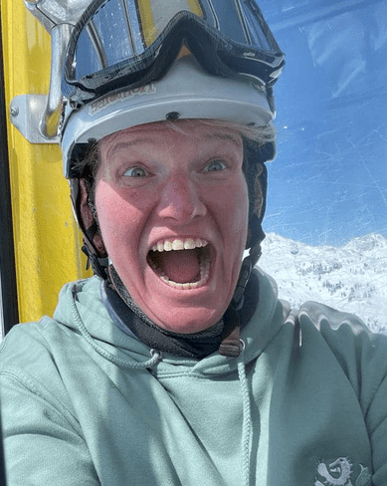
Steff
Trip number 7

Slide 4
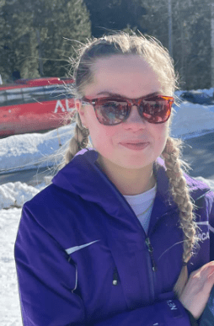
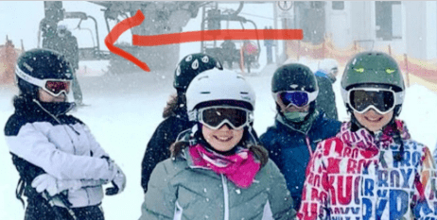
Gemma Nokes
Year 8 in 2017
Miss Nokes
Trip number 5

Slide 5
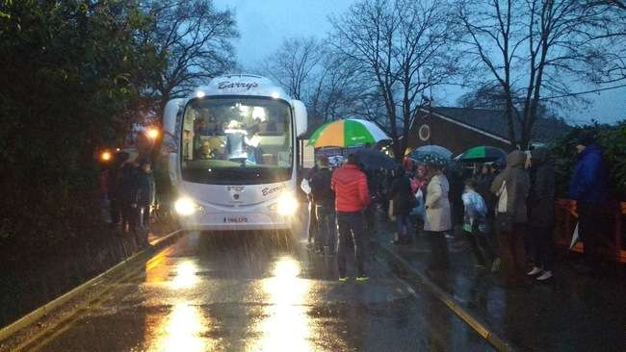
x 3
The journey

Slide 6
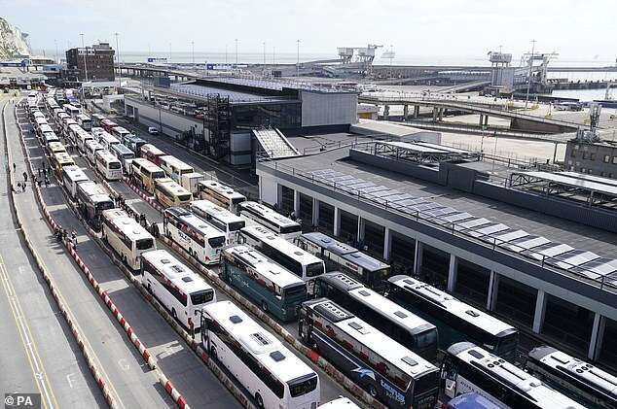

Slide 7
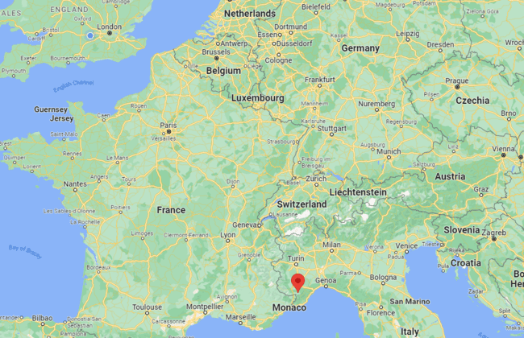

Prato Nevoso/Artesina
More or less 24 hours total
Approximately 16 hours from Calais by coach

Slide 8
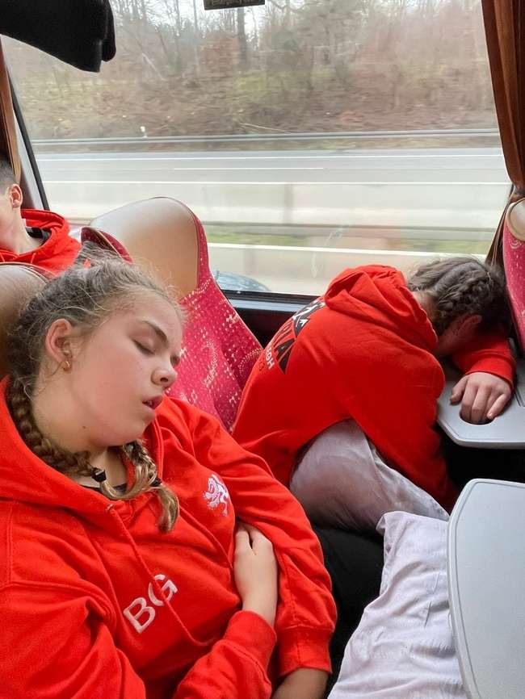
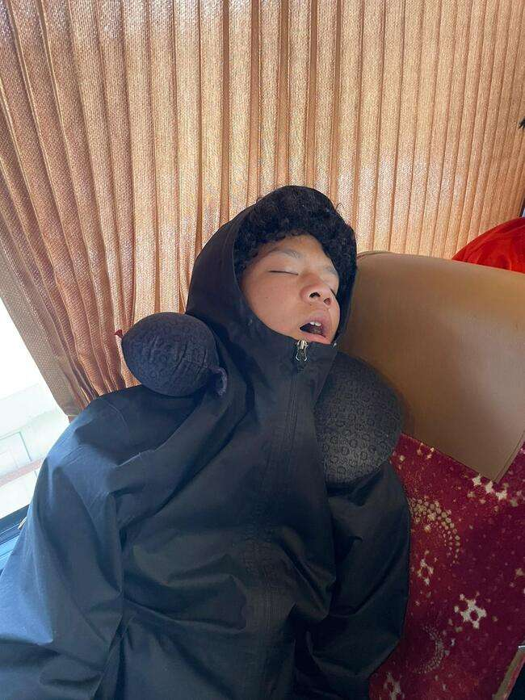
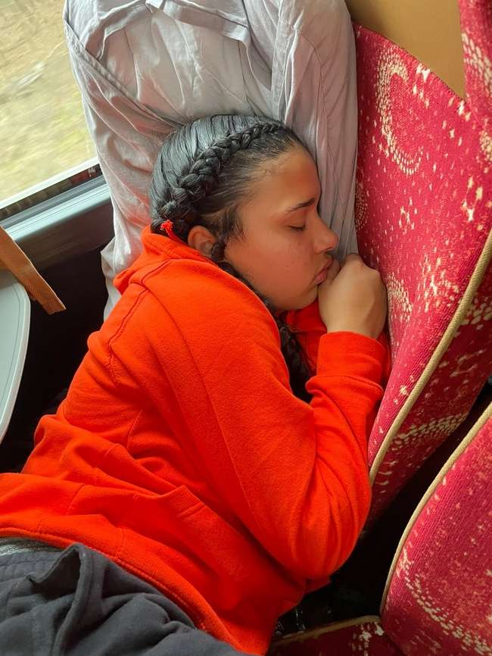
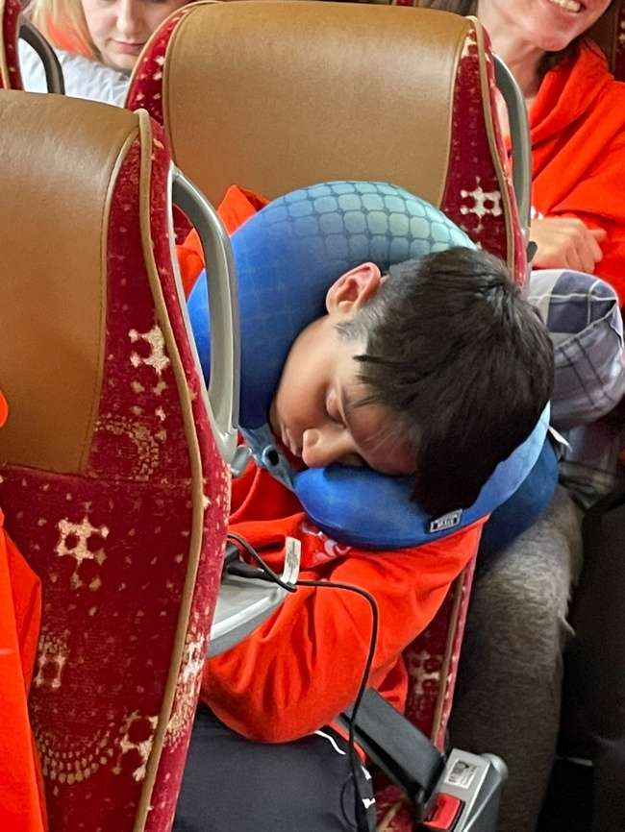
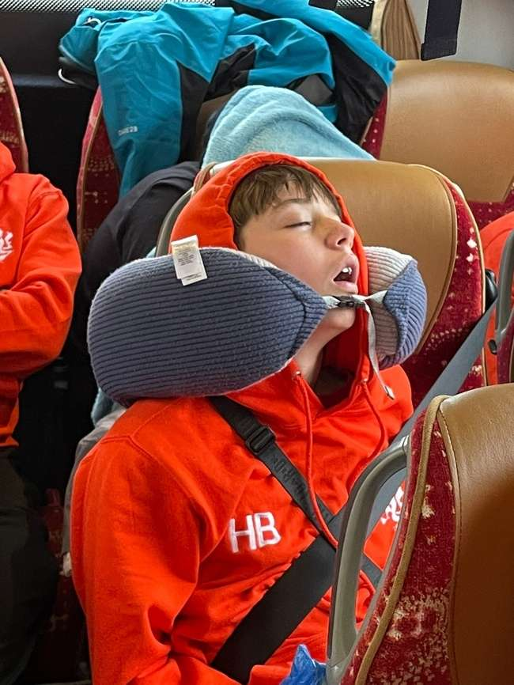
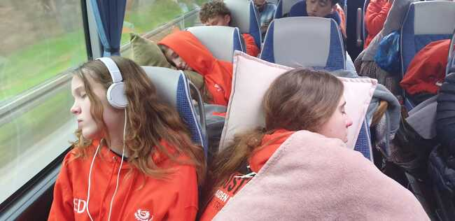
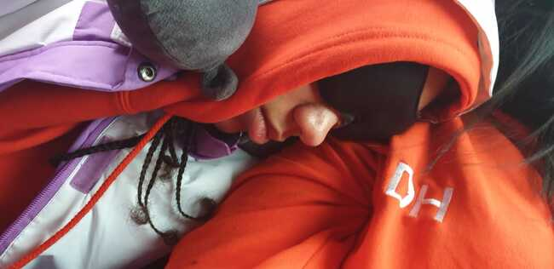

Slide 9
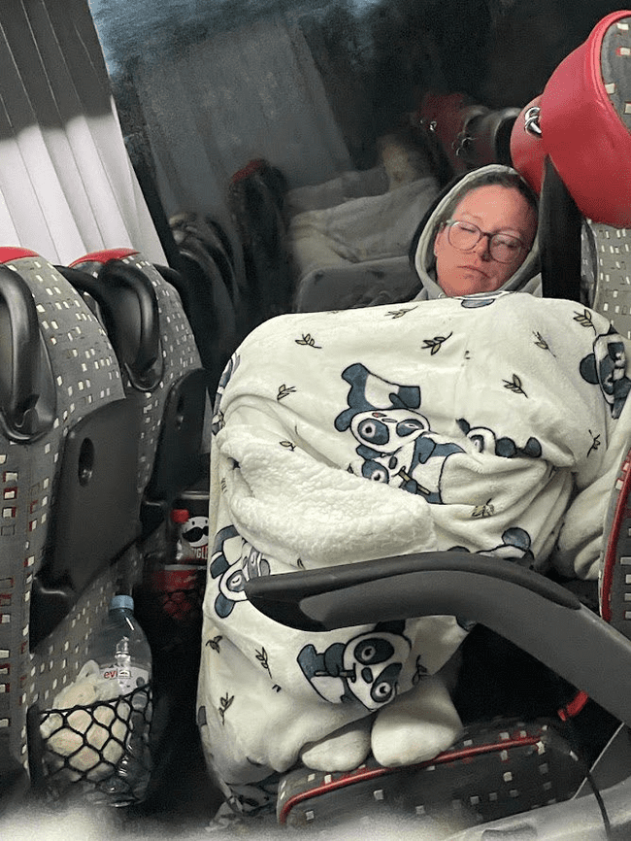
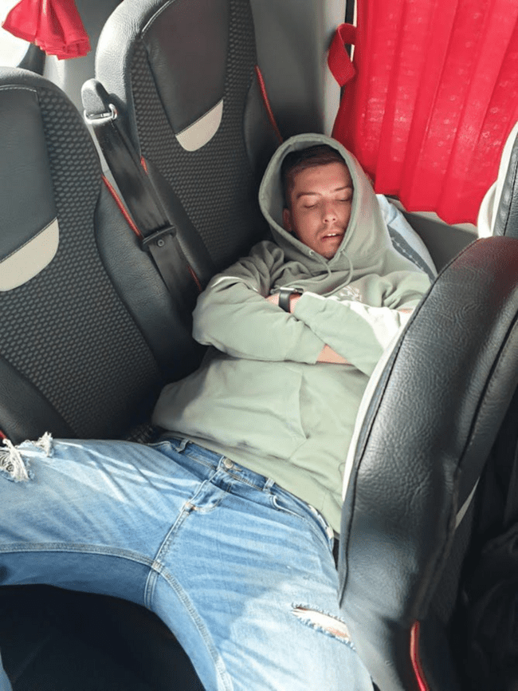
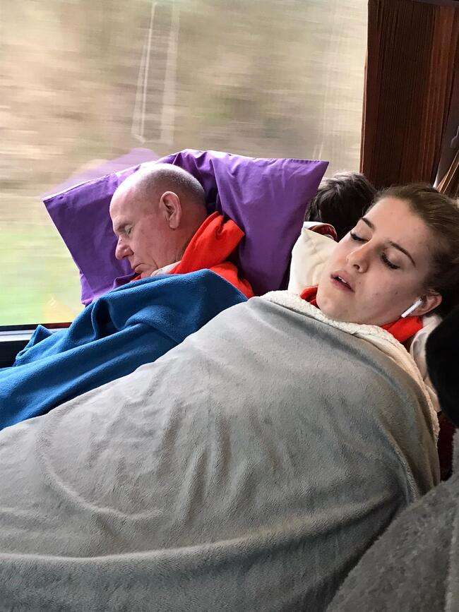

Slide 10
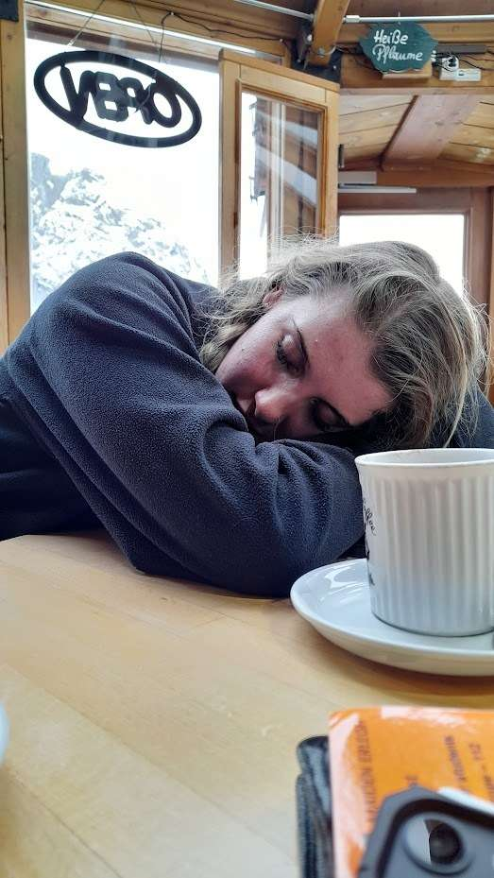
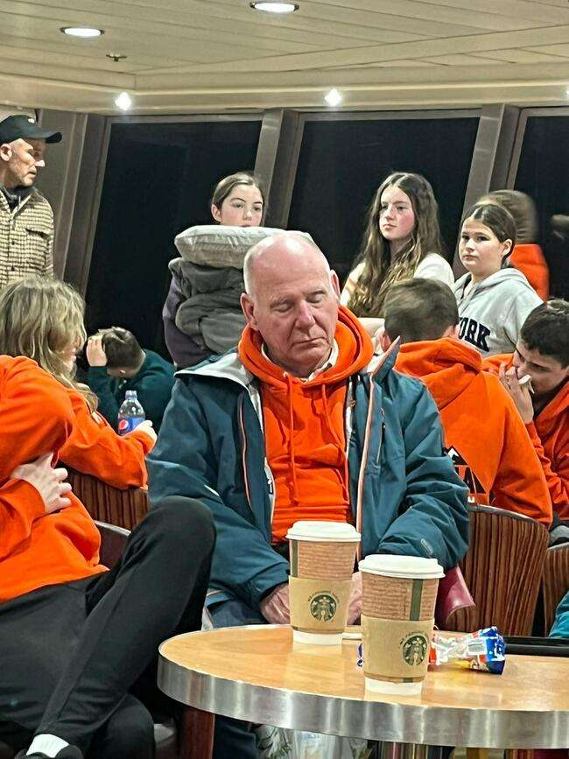
Notes:
Even after skiing

Slide 11
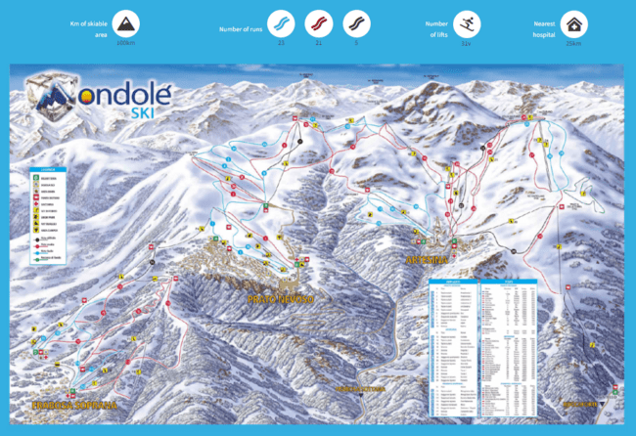
The resort

Slide 12
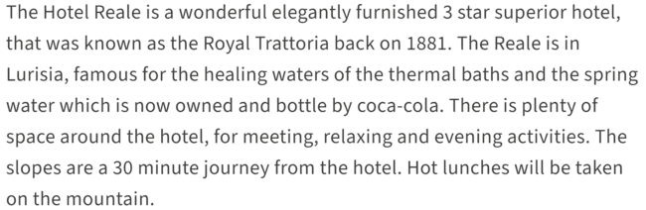
The hotel
Notes:
Will be visiting in January

Slide 13
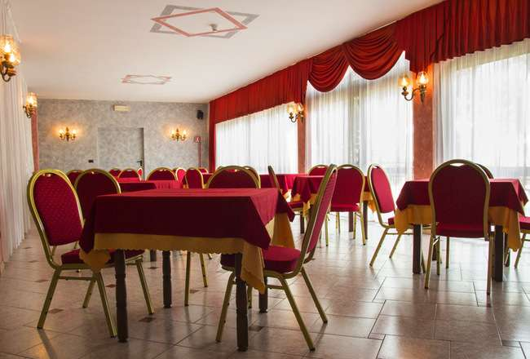
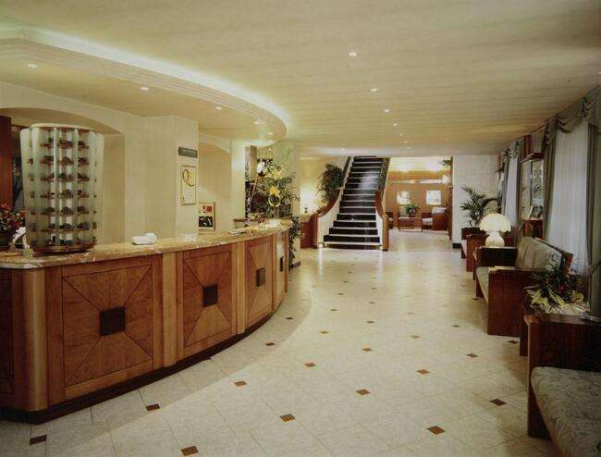
Notes:
Will be visiting in January

Slide 14
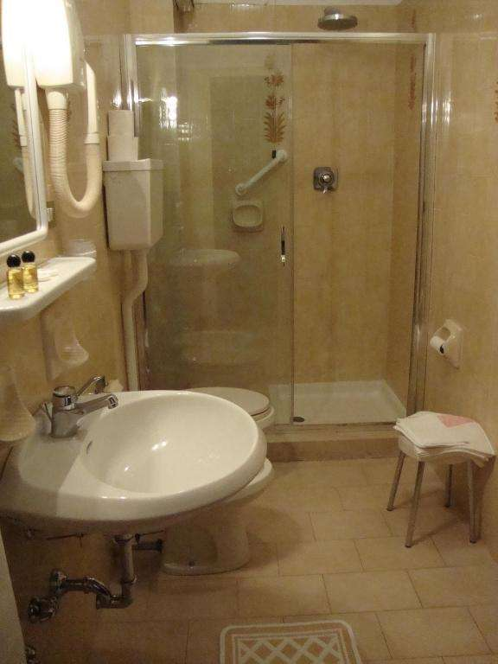
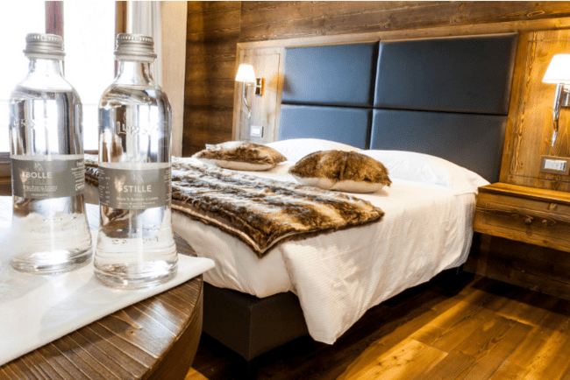
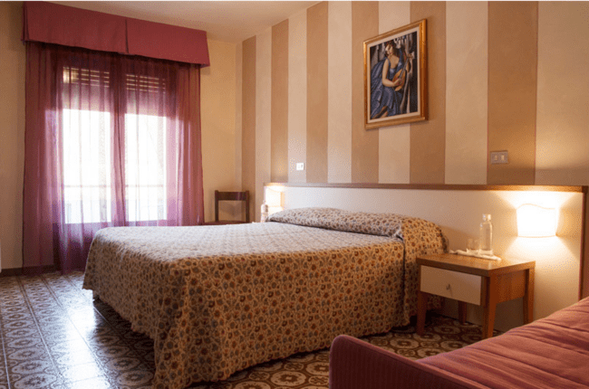
The rooms

Slide 15
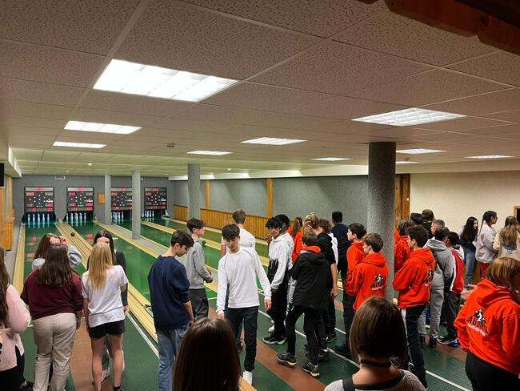
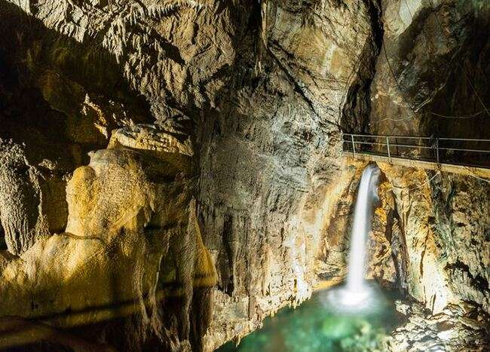

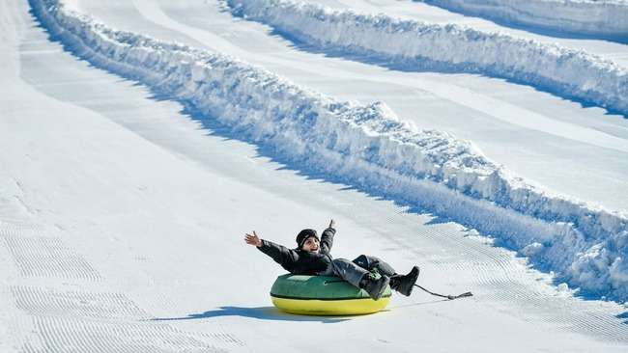
Evenings
Notes:
Thermal Spa

Slide 16
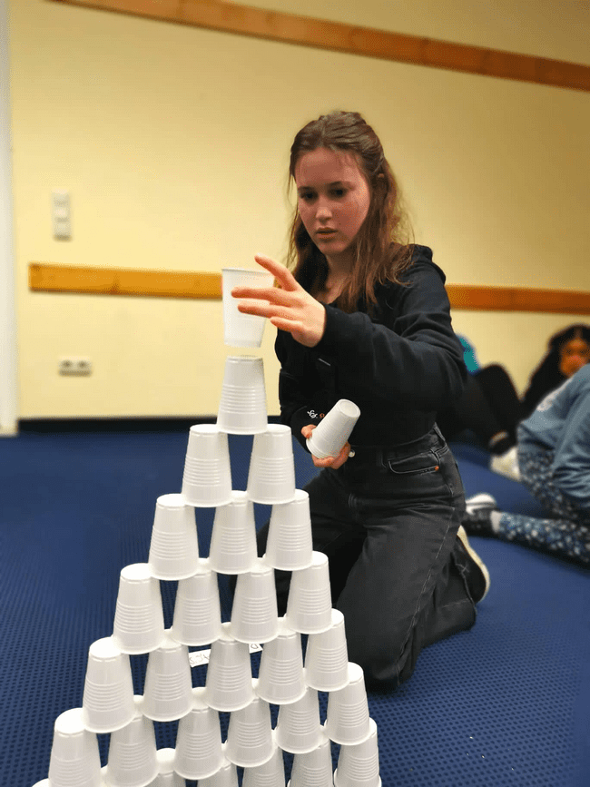
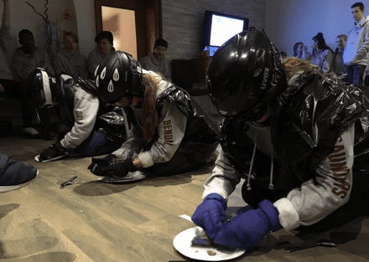
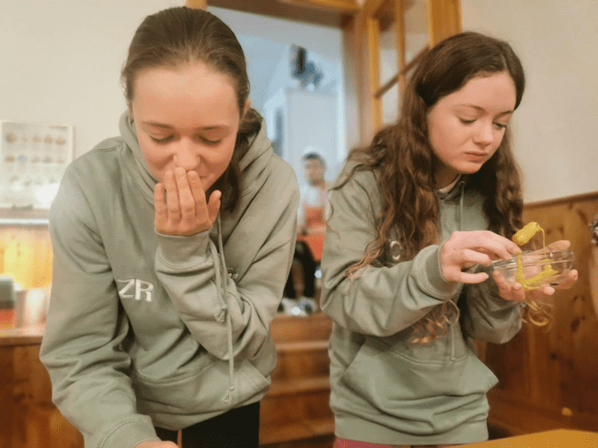
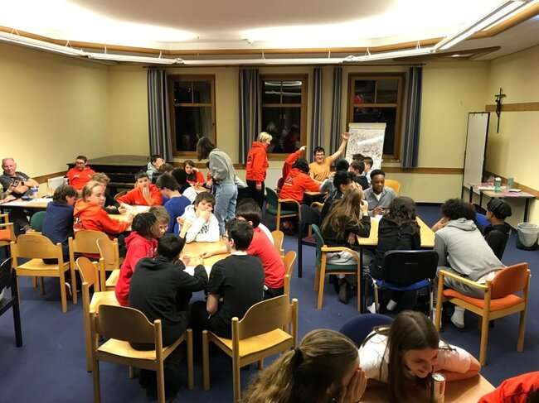
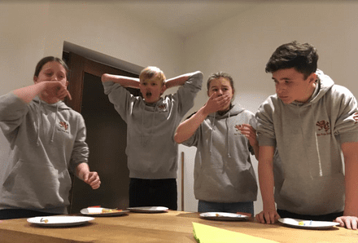
Notes:
Rep’s night

Slide 17
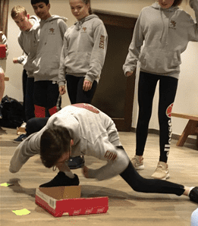
Notes:
Rep’s night

Slide 18
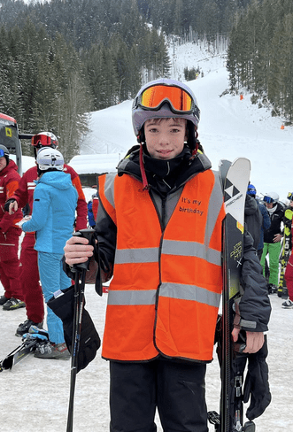
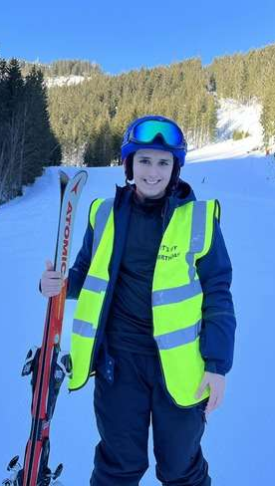
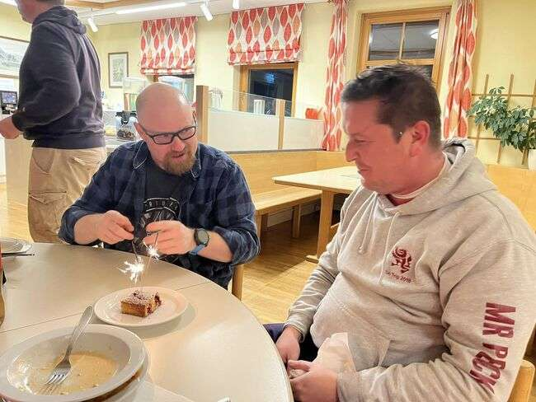

Slide 19
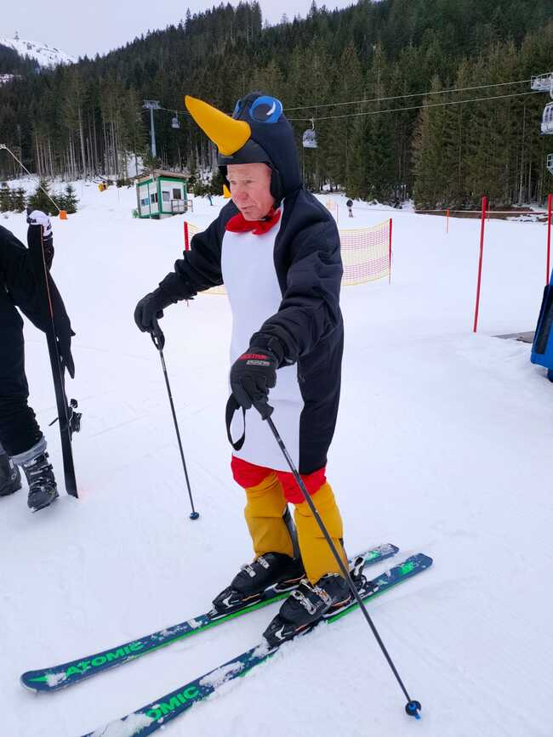
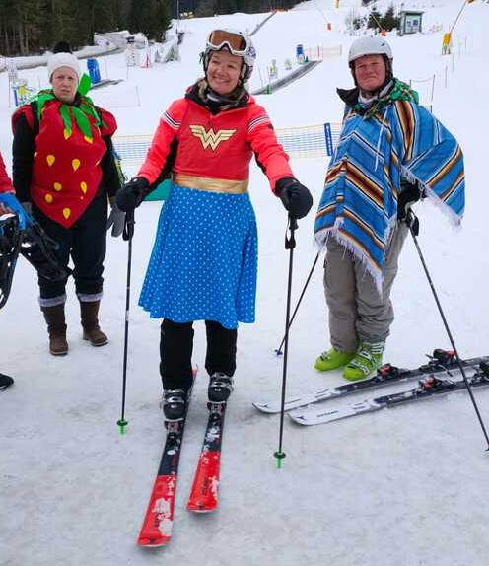
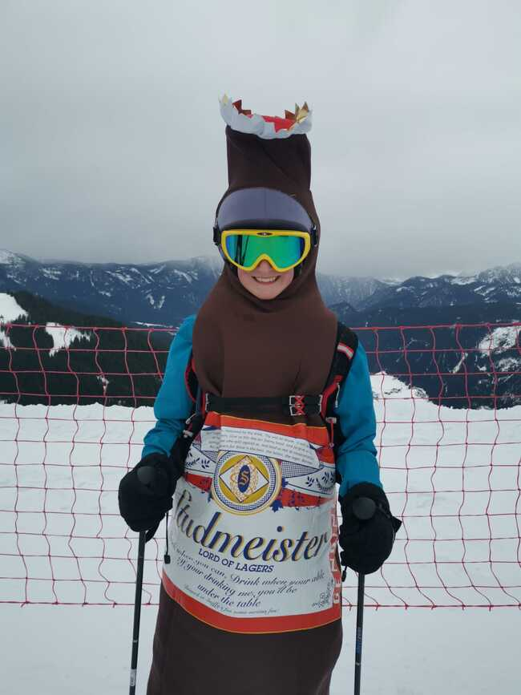
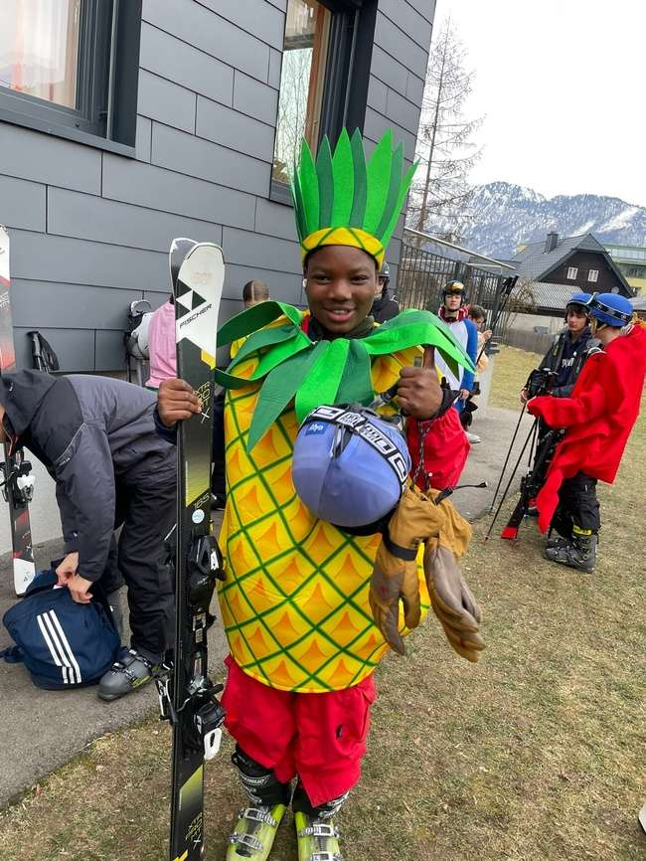
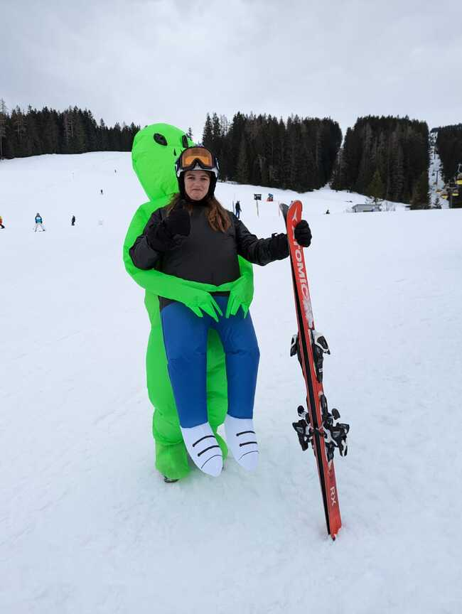
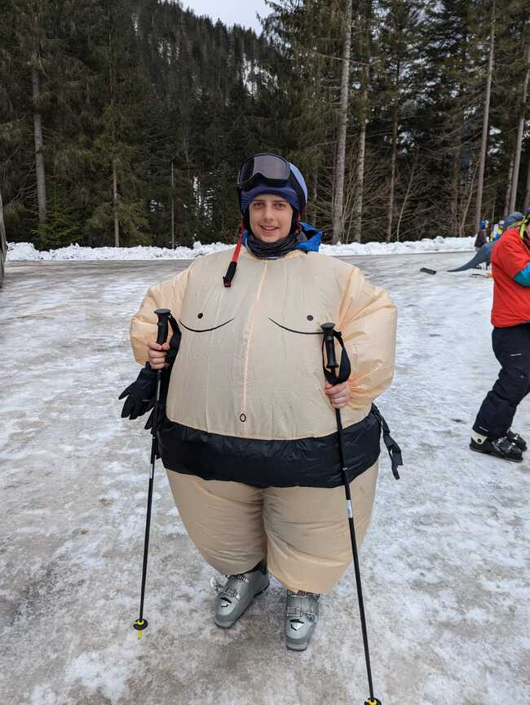
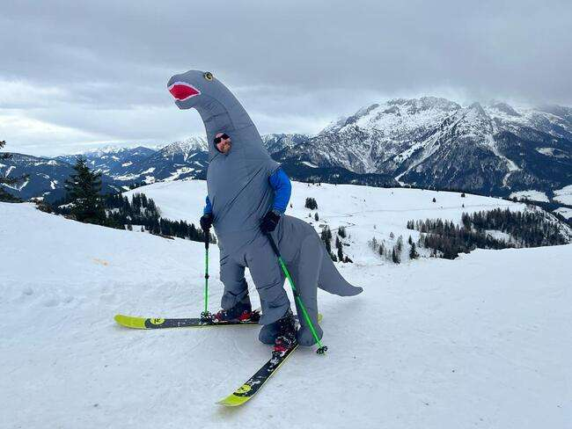
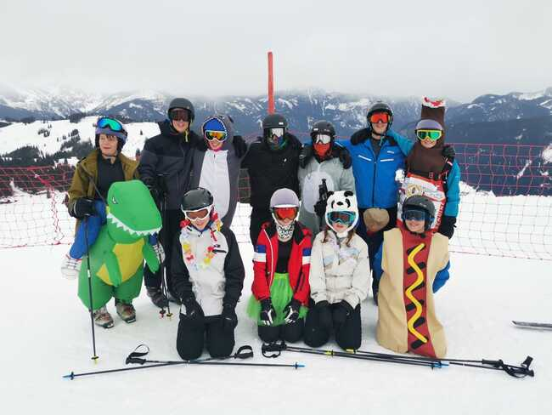
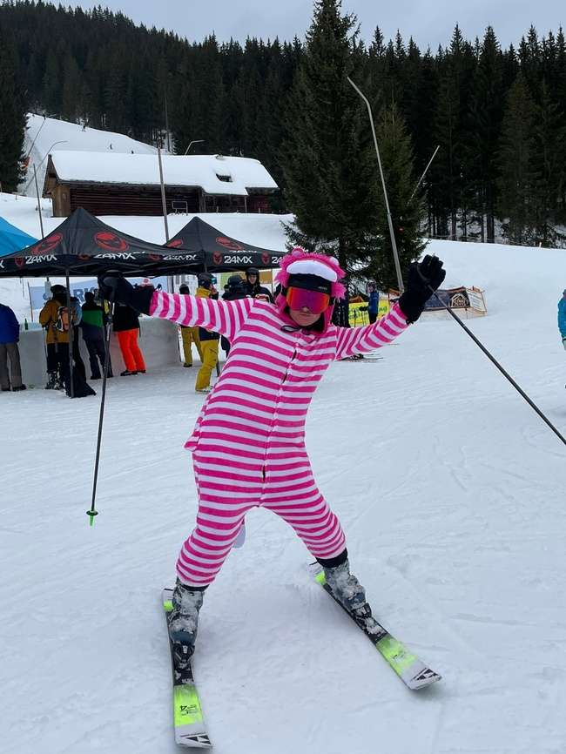
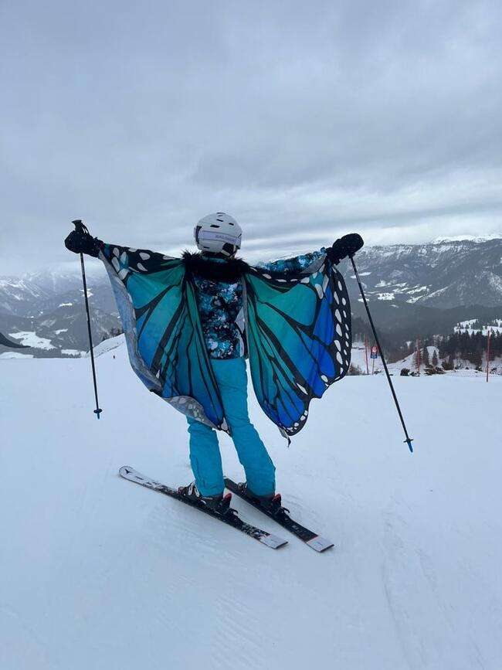
Fancy dress Friday

Slide 20
Skiing is not without its risks…
Notes:
Mia and Ezara – both helicoptered off in 2019
Mai – funny turn. 1 night in hospital. Back skiing later in the week (Dr & parent approved)
Ezara – 2 fractured vertebrae. Last day in fancy dress. Stayed 3 nights and medi-vacced home.
All paid for by insurance
Both back this year :o)

Slide 21
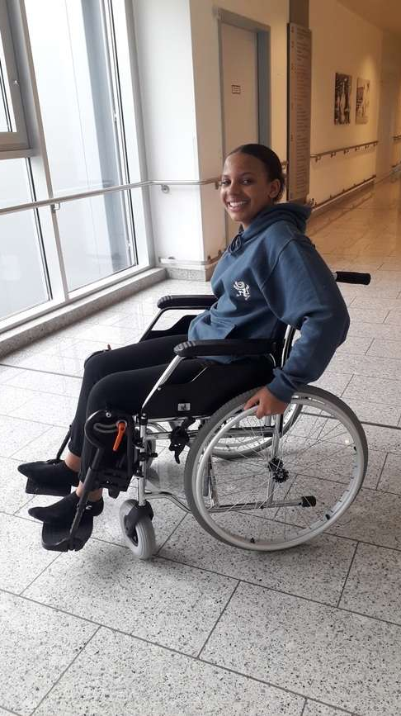
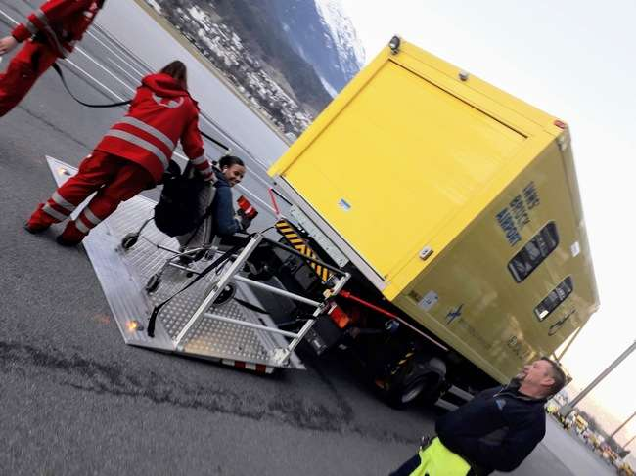
Ezara
Notes:
Mia and Ezara – both helicoptered off in 2019
Mai – funny turn. 1 night in hospital. Back skiing later in the week (Dr & parent approved)
Ezara – 2 fractured vertebrae. Last day in fancy dress. Stayed 3 nights and medi-vacced home.
All paid for by insurance
Both back this year :o)

Slide 22


Ben

Slide 23

MET Ski Trip 2023 - Austria

Slide 24
MET Ski Trip 2025
EASTER
Sansicario / Montgenevre
£1200 - 160 places
Letter in February

Slide 25
Order hoodies from Snow Union
Book dry slope lessons
Fill in the portal

Slide 26



Slide 27

metski@maidenerleghtrust.org
The lovely and wonderful
Hannah Bicknell
Notes:
Bowling in Lavarone

Slide 28
Any questions?

Slide 29


